Slide 1
Item 5.3.
Portfolio on Communication
61st Governing Board Meeting
e-meeting, 27th May 2024

Slide 2
COMMUNICATION PORTFOLIO – LEADERS
SAI of Spain (EUROSAI Secretariat)
Leader of the Portfolio
SAI of Israel (1st Vice-Presidency of EUROSAI)
Co-leader of the Portfolio
ESP 2017-2024
Guiding principle 3
“To promote increased member participation and extend the value of EUROSAI’s activities among its members and other stakeholders through enhanced communications”

Slide 3
AUDIENCES OF EUROSAI
EUROSAI’s target audiences
Member SAIs and their staff
SAI’s target audiences
Auditors and other employees
Key actors and structures
INTOSAI related bodies
Non-SAI stakeholders (International Organisations, EU Organisations and Researchers and Universities)
Governments
NGOs, researchers and universities
Mass media
Citizens
Notes:
For the successful implementation of the initiatives, the Portfolio has been drawn up to properly reach the identified target audiences in EUROSAI as described in the ECF, that is:
EUROSAI’s target audiences (audiences reached directly by EUROSAI as an Organisation):
member SAIs and their staff,
key actors and structures,
INTOSAI related bodies, and
non-SAI stakeholders
and the SAI’s target audiences (audiences reached indirectly through the SAIs):
auditors and other employees,
Governments,
NGOs,
researchers and universities,
mass media
and citizens.

Slide 4
Guiding principles of the ESP 2017-2024
B
Relaunch of a new EUROSAI website
A
Drafting of detailed guidelines
ESP 2017-2024
Guiding principle
“To promote increased member participation and extend the value of EUROSAI’s activities among its members and other stakeholders through enhanced communications”
C
Enhancement of EUROSAI publications
D
Enlarging EUROSAI channels to widely reach out its audience
Fostering promotion of EUROSAI with practical tools
E
Notes:
The leaders of the Portfolio will count with the support of other main actors in communication, such as the Presidency, and will closely coordinate the communication activities with other key players.
The Communication portfolio may include, but not be limited to, the initiatives displayed on screen, which are to be further elaborated in the projects included in the Operational Plan

Slide 5
A.- Drafting of detailed guidelines
New Communication Framework (ECF)
The updated ECF was approved by the XI Congress in April 2021
Notes:
The GB at its 54 meeting (April 2021), entrusted the Portfolio on Communication (period 2021 to 2024) to:
the SAI of Spain (EUROSAI Secretariat) by as a leader of the Portfolio,
and to the SAI of Israel (1st Vice-Presidency of EUROSAI), as a co-leader.

Slide 6
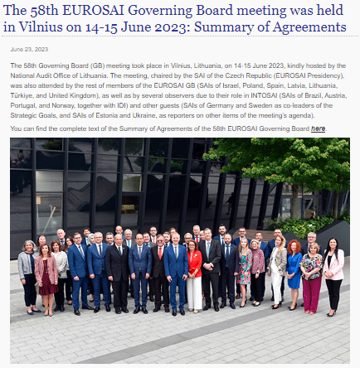
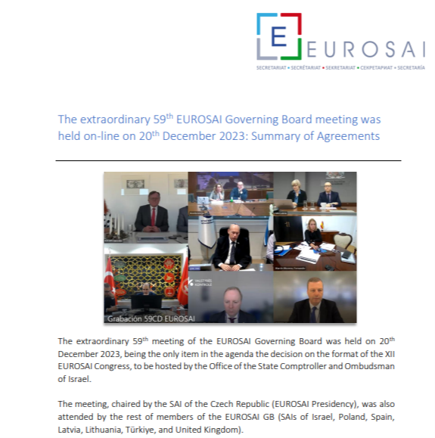
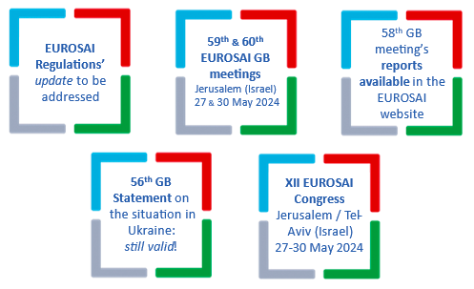
A.- Drafting of detailed guidelines
Development of the Communication Framework
Guidelines for implementing an effective and enhanced communication in EUROSAI (Communication Framework)
✓
Information procedure that takes place after the Congresses and GBs
Formal procedure for the distribution and publicity of the results of the work carried out by the SGs, PGs, WGs & TFs to EUROSAI members

Slide 7
B.- Relaunch of a new EUROSAI website
Revamping of the EUROSAI website
New website is currently in the process of defining the technological framework and functional design
Notes:
RESULTS:
PG for the relaunch of the EUROSAI website (set up in June 2021)
Making EUROSAI activities and products more visible and accessible to members, as well as to other stakeholders
Reach out to all the EUROSAI community and encourage active participation of its members
Draft proposal for a new EUROSAI website presented at 55th GB meeting
Market consultation to determine the maximum amount of the budget for the new EUROSAI website (Published 28/02/2023)
Secretariat’s proposal to submit to EUROSAI’s GB for its approval by written procedure, an authorisation to allocate a maximum amount of € 157,000 (VAT excluded) from the Welfare Fund to the contracting of the new EUROSAI website. The corresponding VAT will also be allocated to the WF. It was approved by written procedure in May 2023
The contract was signed with the company SAGA, Consulting and Software Factory S.L. on 27 November 2023 for 114,610 euros excluding VAT, with a completion period of 14 months
KEY PLAYERS:
EUROSAI Secretariat (leader and administrator of the EUROSAI website)
Participating SAIs: Israel, Czech Republic, UK, Estonia and Sweden (PG for the relaunch of the EUROSAI website)

Slide 8
B.- Relaunch of a new EUROSAI website
PG for the “Relaunch of EUROSAI’s website”
Technical & economic docs (ITC)
- Review & administrative docs (Procurement)
- START
- Approval TCE’s GC
- Adjudication
- Tender procedure: Publication (Procurement)

Slide 9
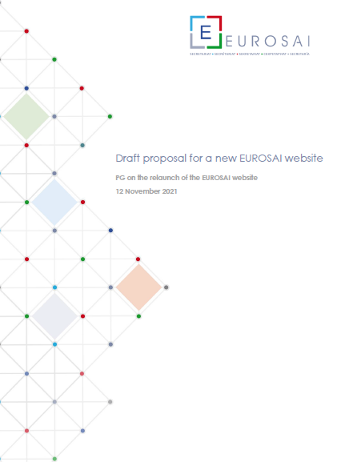
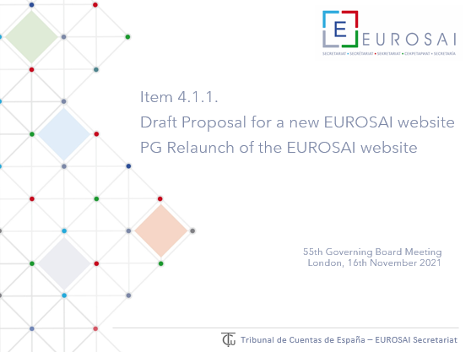
B.- Relaunch of a new EUROSAI website
PROJECT STATUS REPORT
Purpose:
Follow up on the tasks carried out on the project and to report on possible delays according to planned milestones
Web design:
Different designs were proposed
Mock-ups were developed
The PG approved the final version
!
New website Proposal approved during 55th EUROSAI GB meeting

Slide 10
Web design: Final version
Home tab

Slide 11
Web design: Final version
…Home tab

Slide 12
Web design: Final version
…Home tab

Slide 13
Web design: Final version
Database tab

Slide 14
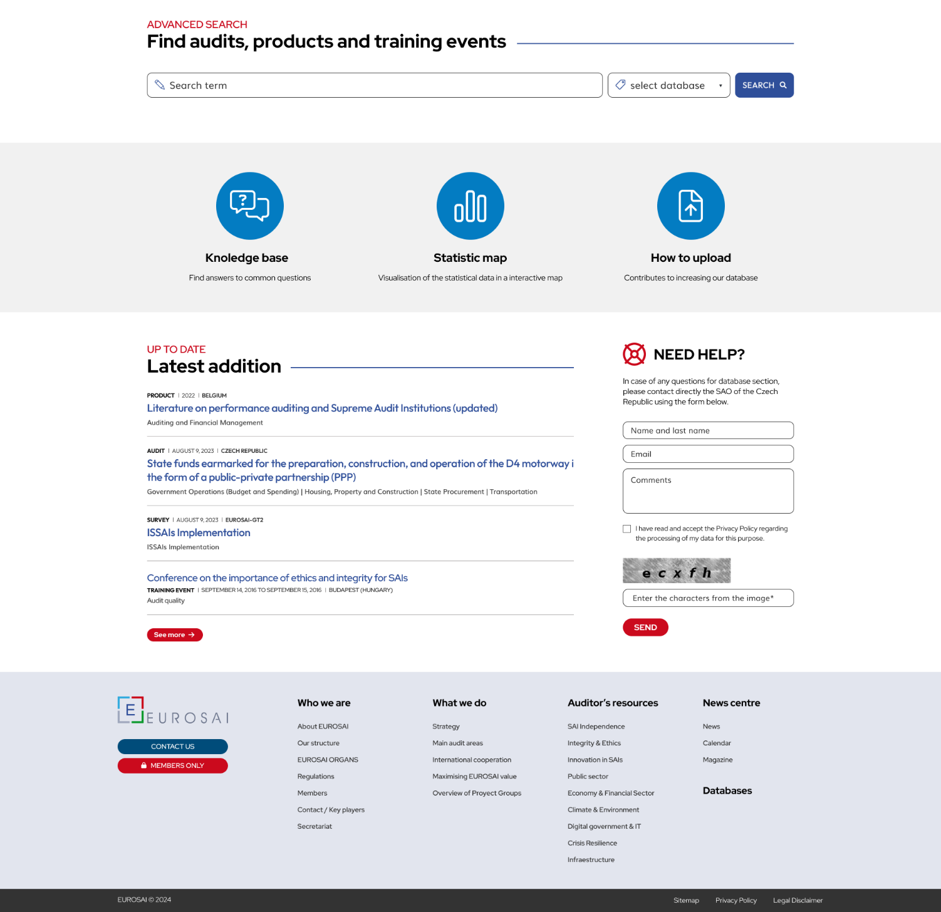
Web design: Final version
… Database tab

Slide 15
Web design: Final version
Database Search

Slide 16
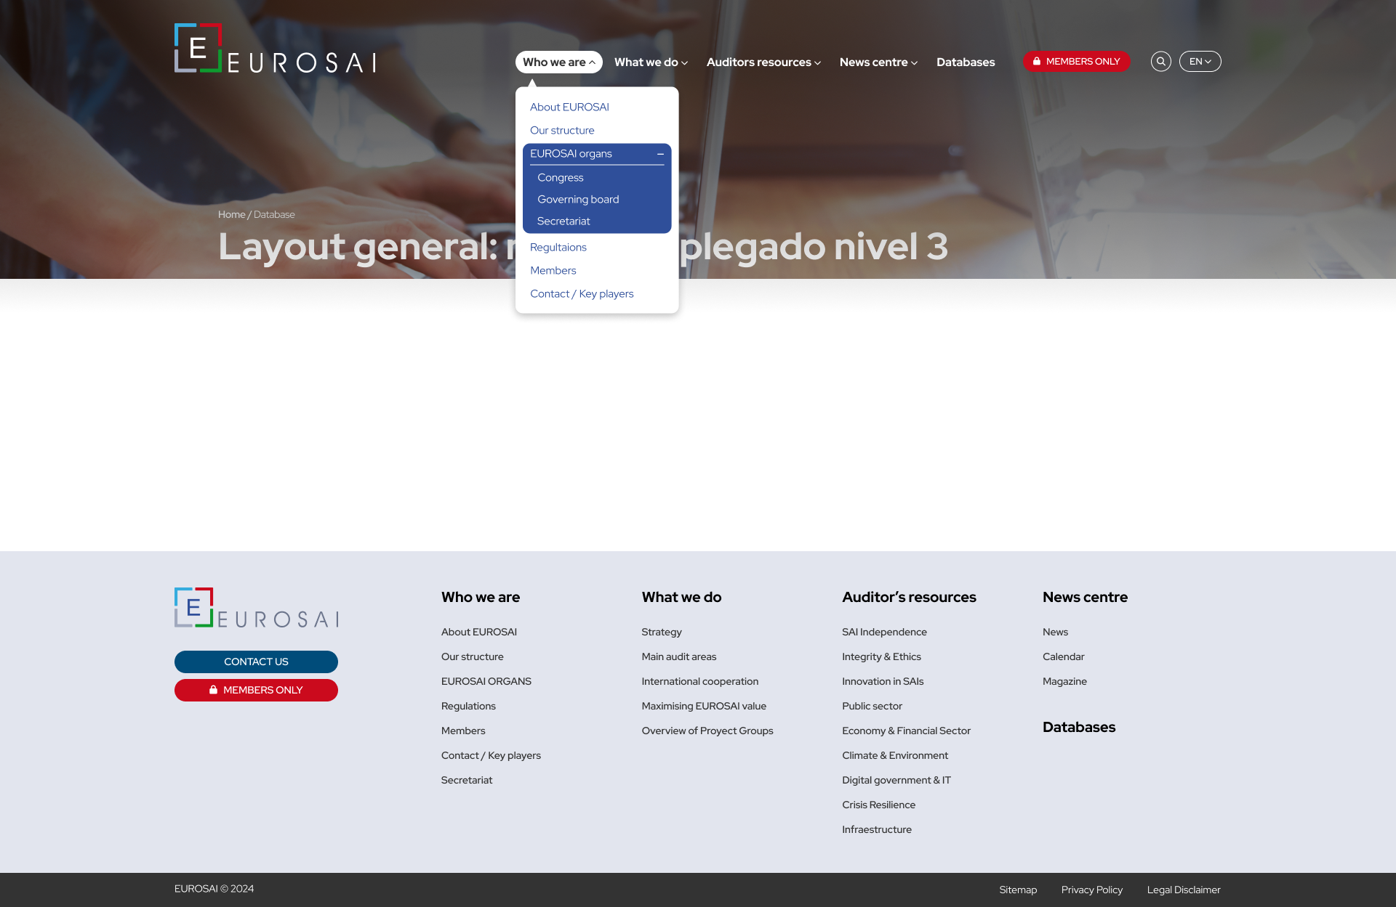
Web design: Final version
Layout menu drop down level 3

Slide 17
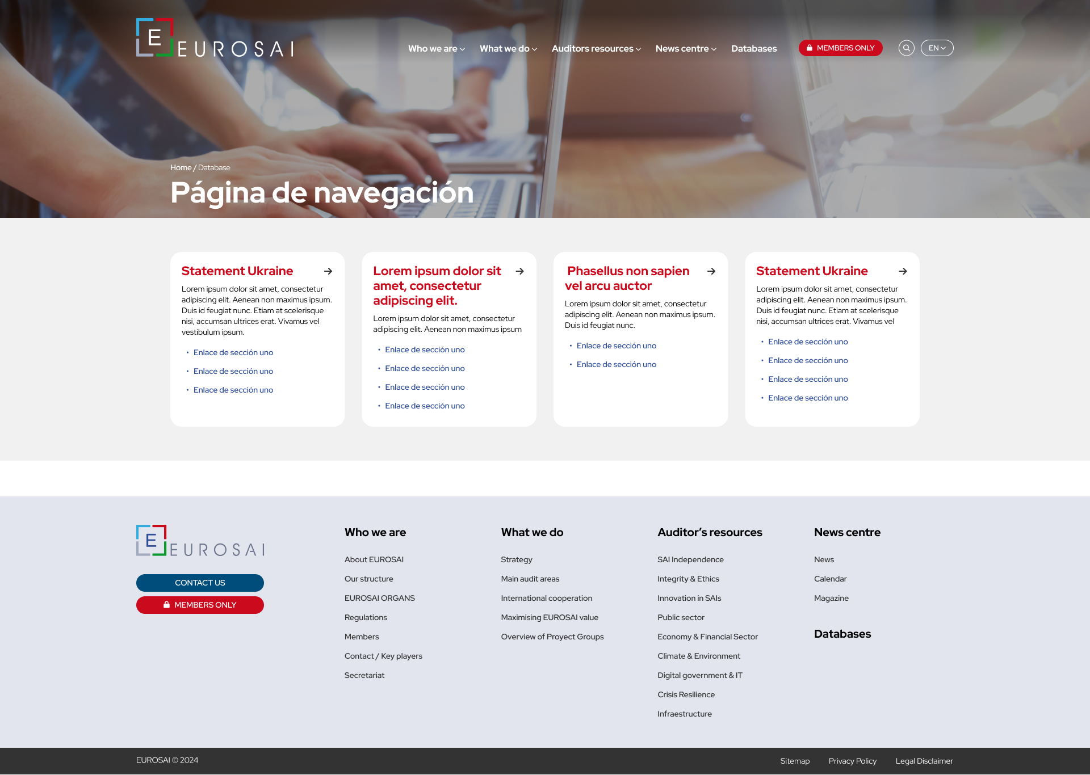
Web design: Final version
Layout navigation page

Slide 18
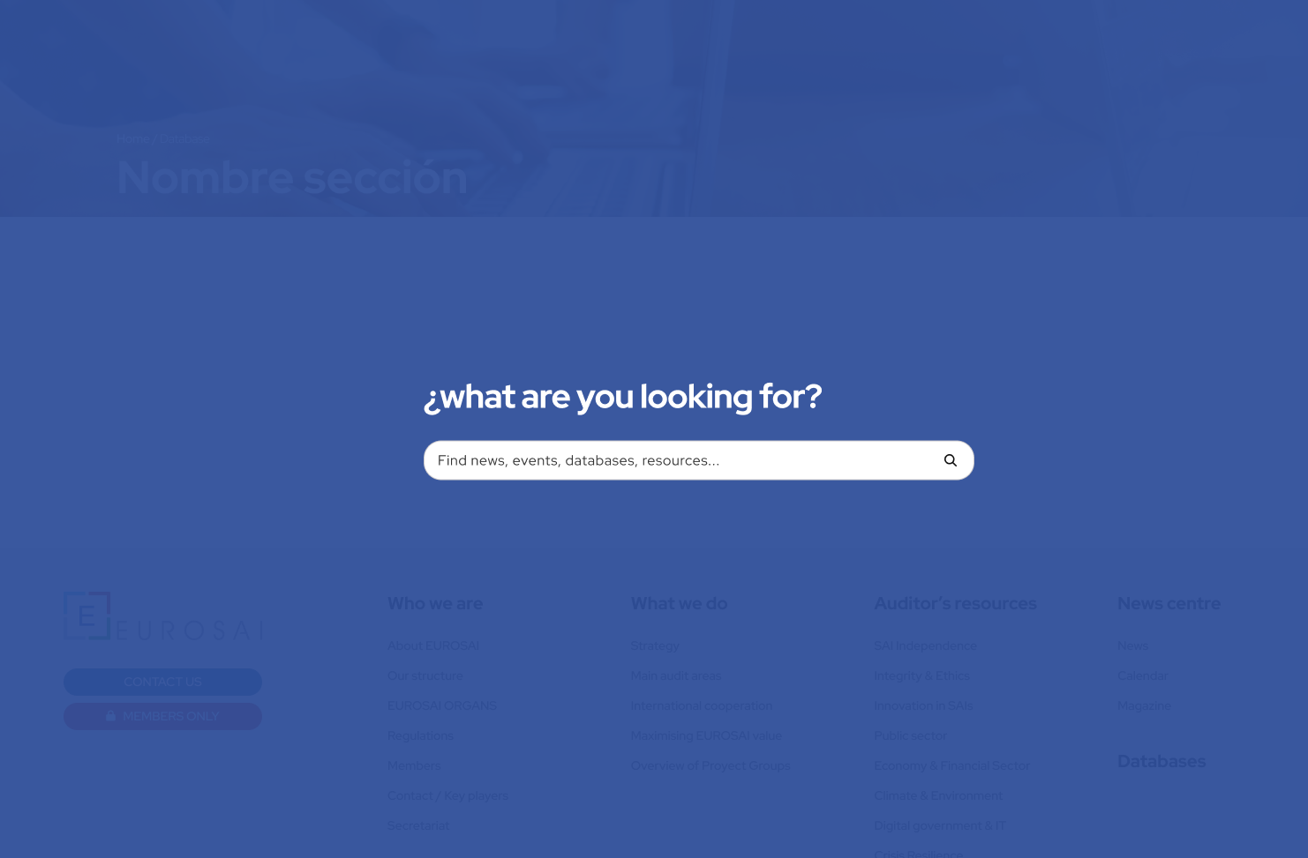
Web design: Final version
General search

Slide 19
B.- Relaunch of a new EUROSAI website
PROJECT STATUS REPORT
Project Planning:
TASK: Construction, launch and management of EUROSAI Web
Phases:
0: Project start
I : Analysis of functional and technical requirements
II: Definition of technological framework
III: Graphic and functional design
IV: Development of templates and architecture of website
V: Content migration
VI: Training and manuals
VII: Installation, tests and system in production
(go live expected January 2025)
VIII: Functional and technological upgrade
IX: Knowledge transfer and administrative closing

Slide 20
B.- Relaunch of a new EUROSAI website
PROJECT STATUS REPORT
4. Ongoing tasks:
Definition of the multilanguage strategy
Members-only area
Migration map of information in the current website.
Content migration will be carried out in consultation with the respective “tab coordinators” (PG members)
Definition of publishing workflows
Setting up a pre-production environment
Finish of the construction of the interior pages.

Slide 21
C.- Enhancement of EUROSAI publications
EUROSAI Magazine
No. 27
Launched: Summer 2023
No. 28
Topic selected: “SAI Performance Measurement Framework”
Call for contributions in the coming weeks
Review of the EUROSAI Magazine’s format
Should follow the launch of the new EUROSAI website
EUROSAI Highlights Newsletter
Regular publication
Responsible: SAI Israel (Newsletter design, calls for topics, etc.)
It can be news from SAIs and INTOSAI, not only from EUROSAI
Notes:
Review of the EUROSAI Magazine
KEY PLAYERS: EUROSAI Secretariat
RESULTS:
Format and content of the EUROSAI Magazine will undergo a major revision
Could be transformed into a digital magazine (selected option in the survey for the relaunch of the EUROSAI website)
EUROSAI Highlights Newsletter
KEY PLAYERS: SAI Israel
The SAI of Israel presented a draft first Newsletter at the 58th Governing Board, but it is not posted on the web
RESULTS:
Facilitate the dissemination of EUROSAI audit related information within SAIs
Regularly published
Condensing useful EUROSAI information for auditors
Modern and attractive design / banner
SAIs’ International Units could translate, if possible, into respective national languages to increase dissemination

Slide 22
D.- Enlarging EUROSAI channels to widely reach out its audience
EUROSAI YouTube channel SAI Israel
Social media and other tools (TBD)
EUROSAI Presidency Social media:
Presidency website: www.eurosai2021.cz
Official X account: EUROSAI Presidency @EUROSAI_OP
Notes:
EUROSAI YouTube channel
KEY PLAYERS: SAI Israel
RESULTS: Promoting and disseminating videos with EUROSAI related content (information on the Organisation, webinars, main outcomes of relevant events and activities, etc.)
The EUROSAI Presidency’s social media are already in place: Presidency official Twitter account
Presidency website
The update of EUROSAI’s information in Wikipedia is pending
Social media and other tools
KEY PLAYERS:
EUROSAI Presidency
SAI Israel
In close consultation with the Secretariat

Slide 23
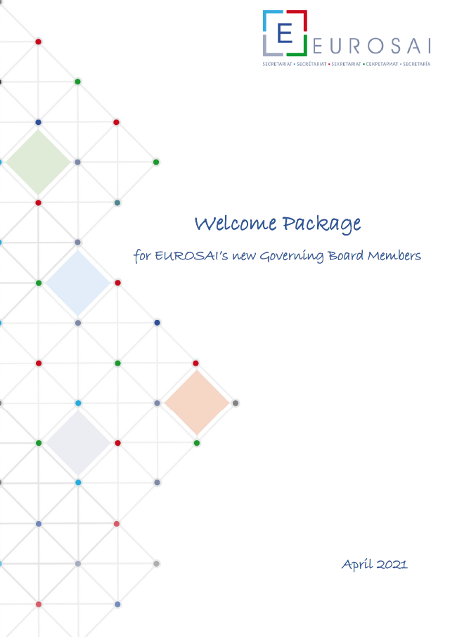
E.- Fostering promotion of EUROSAI with practical tools
EUROSAI Welcome packages to newcomers (to be updated)
New Governing Board members
New EUROSAI First Vice-Presidency
New Heads of SAIs
Promotion of EUROSAI within member SAIs - "Communication Package"
Package with presentations (EUROSAI at a glance), videos, PPTs, leaflet... of EUROSAI activities and outputs, mostly aimed for auditors (to be disseminated within SAIs)
Videos, PPTs, leaflet of EUROSAI activities
and outputs, mostly aimed for auditors
Partially achieved (other responsible parties TBD)
Notes:
EUROSAI Welcome packages to newcomers: New GB members, including incoming Chair (already available) & new Heads of SAIs (Czech Rep is putting the final touches to it)
KEY PLAYERS:
EUROSAI Secretariat
EUROSAI Presidency
RESULTS:
Welcome packages (permanently revised and updated):
New Governing Board members (available)
New EUROSAI First Vice-Presidency (available)
New Heads of SAIs (available)
Promotion of EUROSAI within member SAIs - "Communication Package"
KEY PLAYERS: EUROSAI Presidency
RESULTS:
Booklet “EUROSAI a a glance” was launched in March 2022
The set of templates for EUROSAI reports and PowerPoint presentations have been developed and made available to EUROSAI members

Slide 24
E.- Fostering promotion of EUROSAI with practical tools
Easy and accessible resources to communicate
Templates for reporting, PPTs, ...
Logos for Strategic goals and WGs / TFs
EUROSAI Brand book
Notes:
EUROSAI Welcome packages to newcomers: New GB members, including incoming Chair (already available) & new Heads of SAIs (Czech Rep is putting the final touches to it)
KEY PLAYERS:
EUROSAI Secretariat
EUROSAI Presidency
RESULTS:
Welcome packages (permanently revised and updated):
New Governing Board members (available)
New EUROSAI First Vice-Presidency (available)
New Heads of SAIs (available)
Promotion of EUROSAI within member SAIs - "Communication Package"
KEY PLAYERS: EUROSAI Presidency
RESULTS:
Booklet “EUROSAI a a glance” was launched in March 2022
The set of templates for EUROSAI reports and PowerPoint presentations have been developed and made available to EUROSAI members

Slide 25
Thank you for your attention!
61st Governing Board Meeting
e-meeting, 27th May 2024

