Slide 1
Item 5.3.
Communication Portfolio
Thank you for your attention!
58th EUROSAI Governing Board meeting
Vilnius (Lithuania) 14 – 15 June 2023
50 Governing Board
Item 13
Jūrmala, (Latvia), June 2019
- EUROSAI Secretariat
Tribunal de Cuentas de España – EUROSAI Secretariat

Slide 2
COMMUNICATION PORTFOLIO – LEADERS
SAI of Spain (EUROSAI Secretariat)
Leader of the Portfolio
SAI of Israel (1st Vice-Presidency of EUROSAI)
Co-leader of the Portfolio
ESP 2017-2024
Guiding principle 3
“To promote increased member participation and extend the value of EUROSAI’s activities among its members and other stakeholders through enhanced communications”

Slide 3
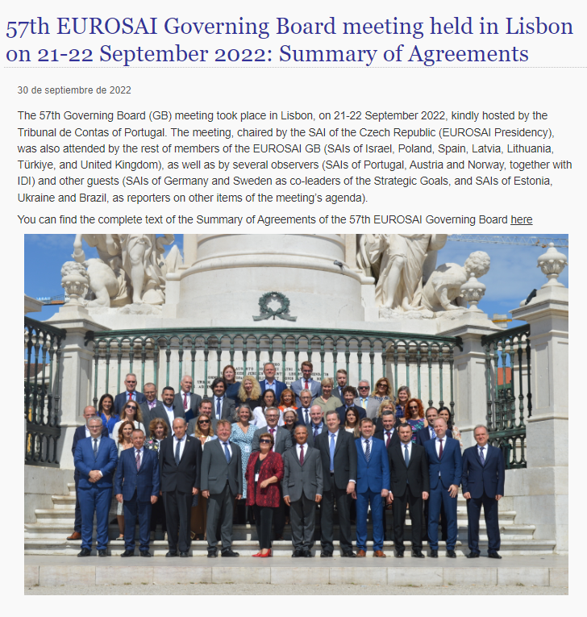
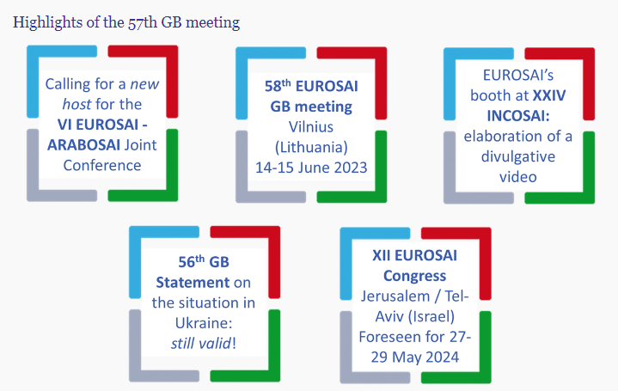
COMMUNICATION PORTFOLIO – MAIN PROJECTS
1. Development of the Communication Framework
Guidelines for implementing an effective and enhanced communication in EUROSAI (Communication Framework)
✓
Information procedure that takes place after the Congresses and GBs
Formal procedure for the distribution and publicity of the results of the work carried out by the SGs, PGs, WGs & TFs to EUROSAI members

Slide 4
COMMUNICATION PORTFOLIO – MAIN PROJECTS
2. PG for the “Relaunch of EUROSAI’s website”
EUROSAI activities and products more visible and accessible to the Organisation's members and stakeholders; reach out to all the EUROSAI community and encourage active participation
Market research published 28/02/2023
Answers until 15/03/2023: 5 companies answered
Analysis of the responses by Secretariat & TIC
One excluded due to technical issues and excessive budget

Slide 5
COMMUNICATION PORTFOLIO – MAIN PROJECTS
2. PG for the “Relaunch of EUROSAI’s website”
COMPARISON CHART- DEVELOPMENT & EXPLOITATION
VAT EXCLUDED
SUPPLIER 1 | SUPPLIER 3 | SUPPLIER 4 | SUPPLIER 5
170.114,40 | 172.681,81 | 212.640,00 | 125.740,90*
(*) Total figure provided by Supplier no. 5 does not coincide with breakdown
(More information in the Secretariat’s report on the results of the market consultation)

Slide 6
COMMUNICATION PORTFOLIO – MAIN PROJECTS
2. PG for the “Relaunch of EUROSAI’s website”
STIC Directorate’s main conclusions:
Pre-offers are usually higher in price than final price
Additionally, they consider the effort (hours) may be lesser
With these in mind, they estimated an average of EUR 157,000, VAT Excluded
Submitted to GB for written approval
Once a web is launched, actualisations around every two years should be taken into consideration. They should be contracted separately, and the estimation of each is around 15% of the initial development
To be considered when drafting next budgets

Slide 7
COMMUNICATION PORTFOLIO – MAIN PROJECTS
2. PG for the “Relaunch of EUROSAI’s website”
Technical & economic docs (ITC)
- Review & administrative docs (Procurement)
- START
- Approval TCE’s GC
- Adjudication
- Tender procedure: Publication (Procurement)

Slide 8
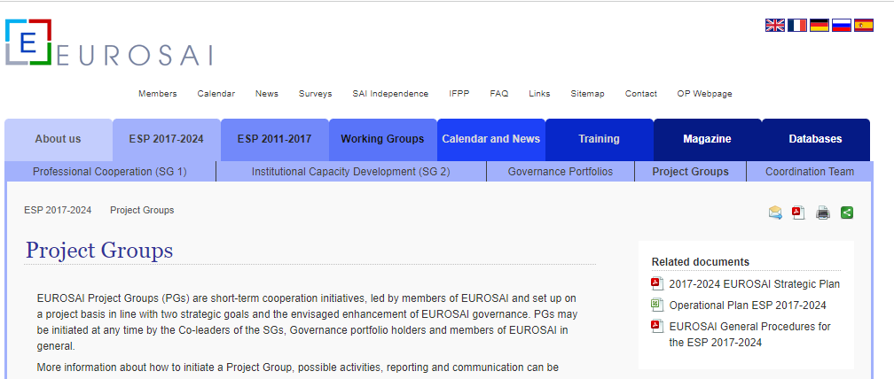
COMMUNICATION PORTFOLIO – MAIN PROJECTS
3. Management and update of the current EUROSAI website
✓
Project Groups’ section update:
Status
Outputs
Notes:
constant updating of the contents of the website

Slide 9
COMMUNICATION PORTFOLIO – MAIN PROJECTS
4. EUROSAI Magazine
No. 27
Proposed theme: "SAIs: in search of citizens' engagement"
Call for contributions in December 2022
Deadline: 31/01/2023 (extended to 30/04/2023)
Estimated launch: Summer 2023
5. EUROSAI Highlights Newsletter
Regular publication
Responsible: SAI Israel (Newsletter design, calls for topics, etc.)
It can be news from SAIs and INTOSAI, not only from EUROSAI
To be launched by June 2023

Slide 10
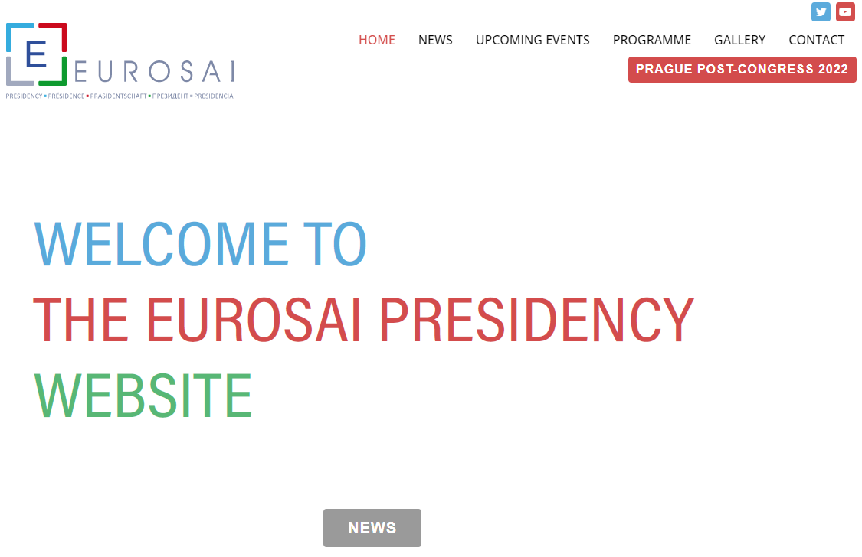
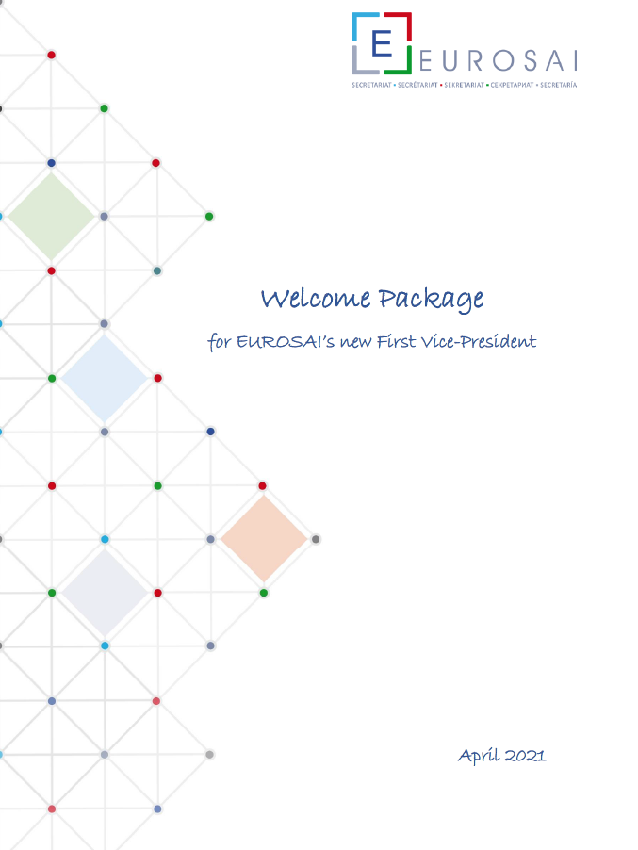
COMMUNICATION PORTFOLIO – MAIN PROJECTS
6. EUROSAI YouTube channel
Responsible SAI: Israel
Twitter, blogging sites, Wikipedia, etc.
EUROSAI Presidency Social media:
Presidency website: www.eurosai2021.cz
Official Twitter account: EUROSAI Presidency @EUROSAI_OP
New Governing Board members (available)
New EUROSAI First Vice-Presidency (available)
New Heads of SAIs (available)
7. Social media and other tools with the EUROSAI's contents
✓
✓
8. EUROSAI Welcome packages to newcomers

Slide 11
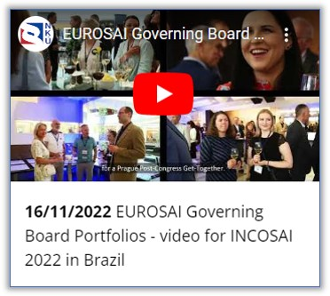
COMMUNICATION PORTFOLIO – MAIN PROJECTS
9. Promotion of EUROSAI within member SAIs - "Communication Package"
Package with presentations (EUROSAI at a glance), videos, PPTs, leaflet... of EUROSAI activities and outputs, mostly aimed for auditors (to be disseminated within SAIs)
Videos, PPTs, leaflet of EUROSAI activities
and outputs, mostly aimed for auditors
(Responsible parties TBD)
Video at the EUROSAI booth at INCOSAI
Easy and accessible resources to communicate (to make easy and user-friendly surveys; to create modern PPTs, ...) (Responsible parties TBD)
e.g.: INTOSAI – DONOR COOPERATION
✓
10. Resource Kit for an enhanced communication

Slide 12
Thank you for your attention!
58th EUROSAI Governing Board meeting
Vilnius (Lithuania) 14 – 15 June 2023

