Slide 1
Item 5.6.
Portfolio of Relations with INTOSAI and its Regional Organisations
Thank you for your attention!
58th EUROSAI Governing Board meeting
Vilnius (Lithuania) 14 – 15 June 2023
50 Governing Board
Item 13
Jūrmala, (Latvia), June 2019
- EUROSAI Secretariat
Tribunal de Cuentas de España – EUROSAI Secretariat

Slide 2
PORTFOLIO HOLDER: EUROSAI SECRETARIAT

Slide 3
Guiding principles of the ESP 2017-2024
Principle 4: Identify, represent and advocate its members’ views and interests on subjects under development in INTOSAI
Channeling fluent and close relations with INTOSAI and its bodies
Principle 6: Enhance its cooperation with other Regional Organizations of INTOSAI fostering different forms of knowledge sharing and cooperation
Enhancing EUROSAI cooperation with other INTOSAI Regional Organisations
A
A
B
B

Slide 4
A
Channeling fluent and close relations with INTOSAI and its bodies
KSC
B

Slide 5
A
Channeling fluent and close relations with INTOSAI and its bodies
INTOSAI Congress (INCOSAI)
EUROSAI Secretariat (as invited guest)
INTOSAI Governing Board
SAIs of Poland & Portugal (EUROSAI representatives) and ECA, as members of the INTOSAI GB and EUROSAI Secretariat as guest
INTOSAI PSC
ECA as chair, SAIs of Norway, Poland & Sweden as members of the Steering Committee. EUROSAI Secretariat as EUROSAI representative
Steering Committee
P2P work stream
Subcommittee Peer review
Workstream ACCC
Audit of Donor Funds
Regional Capacity Development Forum
INTOSAI Regions Coord. Platform &
Round table of Regions
EUROSAI Secretariat, SAI of Poland (as SG2 coleader) and ECA (as chair of PSC)
SAI of the Netherlands (chair)
SAI of Slovakia (chair)
SAI of Sweden ( chair)
SAI of Sweden ( chair)
EUROSAI Secretariat, Presidency & SAI of Poland (SG2 coleader)
EUROSAI Secretariat, Presidency & SAI of Poland (as SG2 coleader)
CBC
INTOSAI Development Initiative (IDI)
EUROSAI Secretariat
INTOSAI Donors Cooperation (IDC) Steering Committee
EUROSAI Secretariat
SCEI
Supervisory Committee on Emerging Issues
EUROSAI Secretariat and ECA (as chair of PSC)
INTOSAI Journal editorial board
EUROSAI Secretariat
Task Force on the INTOSAI Strategic Plan 2023-2028
EUROSAI Secretariat & Presidency

Slide 6
Enhancing EUROSAI cooperation with other INTOSAI Regional Organisations
B
B

Slide 7
EUROSAI Operational plan
Support the EUROSAI Governing Board/Congress in promoting an enhanced cooperation with the INTOSAI and its Regional Organizations, by formulating proposals in line with SGs and ensuring appropriate representation in INTOSAI of EUROSAI interests
Foster dialogue with all Regional Organizations in INTOSAI fora meetings to identify areas and topics of mutual interest
Coordinate knowledge sharing and cooperation activities on topics of mutual interest between bodies and actors of EUROSAI and their peers in the other INTOSAI Regional Organizations
To support the organization of joint events with added value for participants, according to ToR approved by the GB and agreed with ASOSAI, OLACEFS and ARABOSAI
Implementation of cooperation with AFROSAI

Slide 8
EUROSAI Operational plan
Support the EUROSAI Governing Board/Congress in promoting an enhanced cooperation with the INTOSAI and its Regional Organizations, by formulating proposals in line with SGs and ensuring appropriate representation in INTOSAI of EUROSAI interests
EUROSAI Secretariat
Coordination Team
EUROSAI representatives in INTOSAI GB
INTOSAI IDC Steering Committee ( 27-sep 22)
XXIV INCOSAI Congress in Rio de Janeiro 7-11 Nov 22
76th INTOSAI GB meeting. 7 Nov 22. Rio de Janeiro
CBC Steering Committee (20 Sept 2022)
PSC Triennial Main Committee meeting (8 Nov 2022)

Slide 9
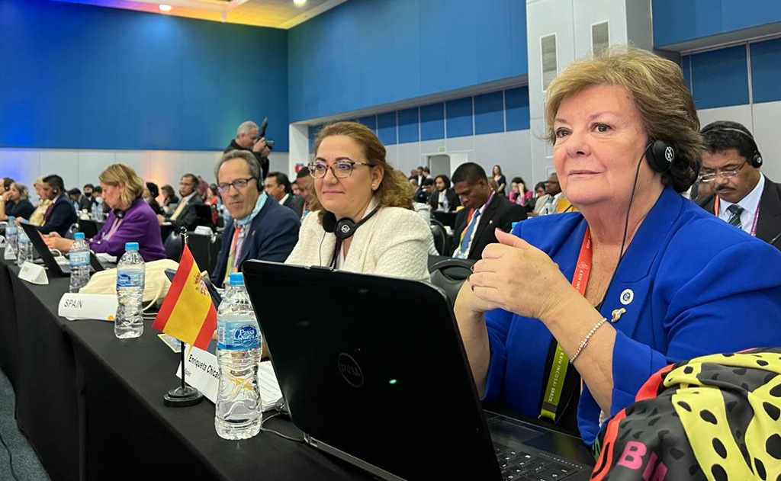
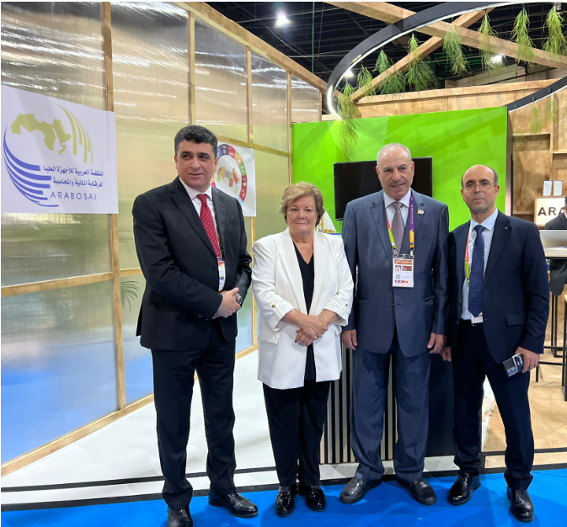
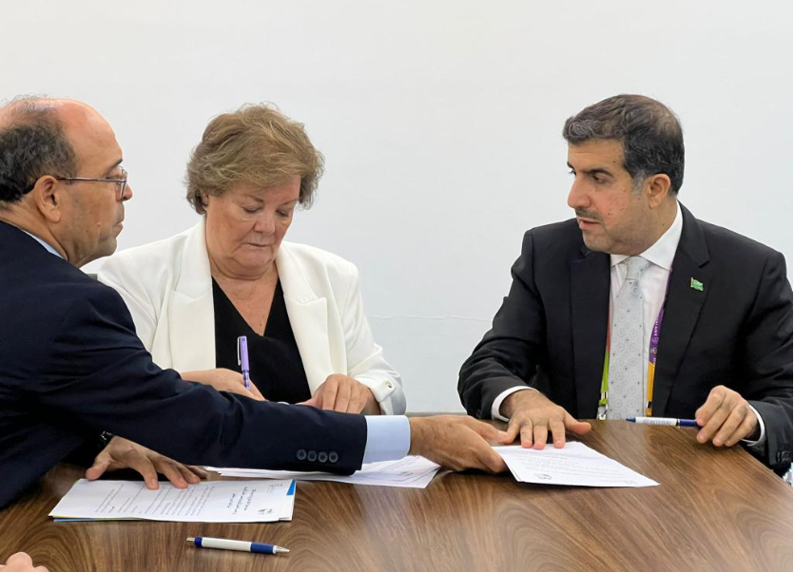
EUROSAI Operational plan
EUROSAI Secretariat & Key players
Foster dialogue with all Regional Organizations in INTOSAI fora meetings to identify areas and topics of mutual interest
Addendum EUROSAI – ARABOSAI, signed in Rio de Janeiro (Brazil). 10th Nov 2022, with two main areas of collaboration:
Sustainable Development Goals (SDGs)
Information Technologies (IT) audits

Slide 10
EUROSAI Operational plan
EUROSAI Secretariat & Key players
Coordinate knowledge sharing and cooperation activities on topics of mutual interest between bodies and actors of EUROSAI and their peers in the other INTOSAI Regional Organizations
IDI Regional Guidance Workshop on Strategic Management 28-30/sept/2022
Meetings and information regarding IDI initiatives:
LOTA
EFA
CCAA
January 2023: announcement of the start of work on the INTOSAI Global Survey and the Global SAI Stocktaking Report 2023
CBC-EUROSAI catch-up meeting: March 2023:
Presentation by the P2P(Netherlands and United Kingdom)
SAI PMF – recent developments
Annual meeting CCC OLACEFS
II Meeting on the establishment of a proactive advocacy mechanism to advocate for SAI independence April 2023
→ Guidance Note on Strategic Management for INTOSAI Regional Organisations published!!

Slide 11
EUROSAI Operational plan
EUROSAI Secretariat & Key players
To support the organization of joint events with added value for participants, according to ToR approved by the GB and agreed with ASOSAI, OLACEFS and ARABOSAI
VI EUROSAI- ARABOSAI Joint Conference →
NO candidacies received
ASOSAI – EUROSAI Joint Conference
(ASOSAI secretariat has communicated
no candidates so far)
Redefine the TORs ?→ make them more appealing
Interest from OLACEFS
2024???
Notes:
Cuando tendría que serla próxima joint conference con OLACEFS ( Euro-Ola u OLA Euro)

Slide 12
EUROSAI Operational plan
EUROSAI Secretariat & Key players
Implementation of cooperation with AFROSAI
Mutual exchange of lists of training events planned in both Regional Organisations for their knowledge and eventual participation
→ No activity
Financial support for the implementation of the cooperation activities between EUROSAI and AFROSAI
→ N/A

Slide 13
Upcoming events INTOSAI
IIQ 2023
CBC – Annual meeting 2023 & IDSC – 16th Meeting of the INTOSAI-Donor Cooperation Steering Committee (19 - 23 June 2023). Hybrid/Jamaica
PSC - 22nd Meeting of the Steering Committee (28 June 2023). Virtual meeting
III & IVQ 2023
SCEI meeting -19th-21st July. Foz de Iguazu (Brazil)
PSC Steering Committee (27-28th Sept). Luxembourg
77th Meeting of the Governing Board of INTOSAI (20-21 November 2023). Vienna (Austria)

Slide 14
Thank you for your attention!
58th EUROSAI Governing Board meeting
Vilnius (Lithuania) 14 – 15 June 2023
- EUROSAI Secretariat

