Slide 1
EUROSAI
Secondments Programme

Slide 2
Objectives and benefits of the Secondment Programme
Technical provisions
Background

Slide 3
Background
Approved by the EUROSAI Governing Board in 2017.
SAI Czech Republic took over from SAI Poland in 2023 (ToR approved in April 2023).
Linked to EUROSAI Strategic Goal 2:
objective 2.1: To facilitate and support needs driven institutional capacity development initiatives.

Slide 4
Objectives and benefits of the Secondment Programme
Build mutual understanding between SAIs.
Insight into various audit approaches.
Exposure to new and innovative audit methods.
Professional development of secondees.
Professional growth of staff members of hosting SAIs.
Networking opportunities.

Slide 5
Technical provisions
Confirm the willingness to host a secondee.
Provide supervision and guidance.
Meet the goals set by the secondee.
Sending SAI arranges travel, medical insurance and accommodation.

Slide 6
Identification of topic and preferably also the hosting SAI
Submit the intention to apply for funding to the EUROSAI Secretariat
Enjoy your secondment ☺ (max. of 10 days)
Submit a short final report to SAI Czech Republic
Submit request for financial backup to the EUROSAI Secretariat
Contact and inform SAI Czech Republic
Agree on the dates and scale of the secondment
Contact the hosting SAI

Slide 7
Possibility to receive funding from the EUROSAI Budget.
Financial Rules 3.1 – the programmes set up by EUROSAI such (e.g. staff secondments) can be subject to financial request from EUROSAI (Rule 45).
Link to EUROSAI Subsidies including video of a Power Point presentation with the necessary templates (official letter and report included).
Requests for funding – 3 times a year (January, May, September).
Financial provisions
Secondment placements at SAI Czech Republic
Pilot Secondment

Slide 8
Financial provisions
Secondment placements at SAI Czech Republic
Pilot Secondment

Slide 9
1 placement at Audit Quality Management Unit.
1 placement at Analyses and Audit System Administration Unit.
1 placement at Social Affairs, the Environment, Education, Culture, and Healthcare Audit Department.
1 placement at Performance Audit Department (secondment focused on digitalisation of public administration, eGovernment, vendor lock-in, legacy information systems, ICT).
1 placement at the International Relations Department.
Financial provisions
Secondment placements at SAI Czech Republic
Pilot Secondment
Hints for successful secondment
2 staff members of SAI Czech Republic were hosted by SAI Netherlands in September 2023 (Design Studio)

Slide 10
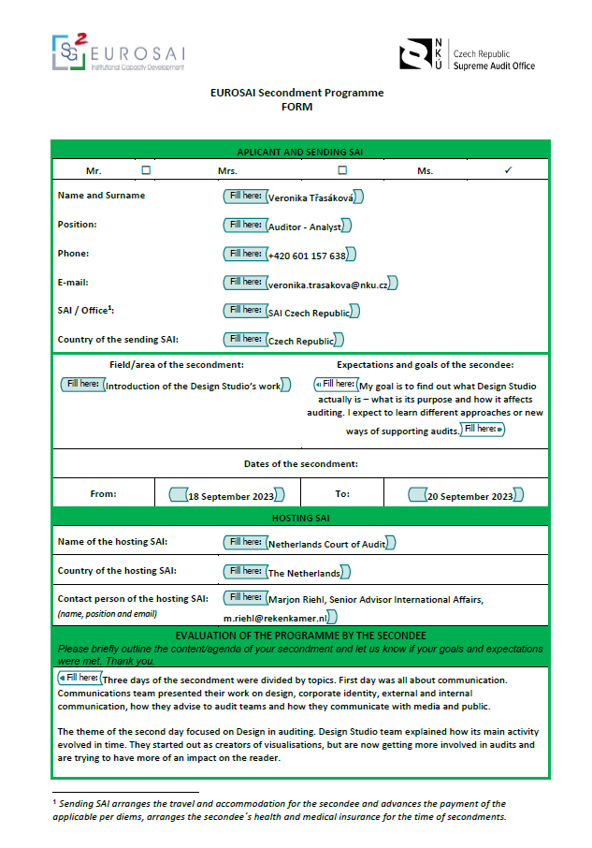
1 placement at Audit Quality Management Unit.
1 placement at Analyses and Audit System Administration Unit.
1 placement at Social Affairs, the Environment, Education, Culture, and Healthcare Audit Department.
1 placement at Performance Audit Department (secondment focused on digitalisation of public administration, eGovernment, vendor lock-in, legacy information systems, ICT).
1 placement at the International Relations Department.
Financial provisions
Secondment placements at SAI Czech Republic
2 staff members of SAI Czech Republic were hosted by SAI Netherlands in September 2023 (Design Studio)
Pilot Secondment
Hints for successful secondment

Slide 11
2 staff members of SAI Czech Republic were hosted by SAI Netherlands in September 2023 (Design Studio)
Secondment placements at SAI Czech Republic
Pilot Secondment
Hints for successful secondment
Please share this information!
Set goals and objectives for your professional secondment.
Reach out to the colleagues in hosting SAIs beforehand.
Gather information about your hosting SAI and the culture of the country before travelling.
Ask questions and ask for feedback.
Stay in contact with the colleagues in the hosting SAI after the secondment is over.
Make sure you share and use the gained experience back at home.

Slide 12
Secondment placements at SAI Czech Republic
Pilot Secondment
Set goals and objectives for your professional secondment.
Reach out to the colleagues in hosting SAIs beforehand.
Gather information about your hosting SAI and the culture of the country before travelling.
Ask questions and ask for feedback.
Stay in contact with the colleagues in the hosting SAI after the secondment is over.
Make sure you share and use the gained experience back at home.
Hints for successful secondment
Please share this information!
Please share and disseminate this information within your institution and try to identify both the staff members interested in the secondment and the positions that can be offered to your colleagues from other EUROSAI members.

Slide 13
Set goals and objectives for your professional secondment.
Reach out to the colleagues in hosting SAIs beforehand.
Gather information about your hosting SAI and the culture of the country before travelling.
Ask questions and ask for feedback.
Stay in contact with the colleagues in the hosting SAI after the secondment is over.
Make sure you share and use the gained experience back at home.
Pilot Secondment
Hints for successful secondment
Please share and disseminate this information within your institution and try to identify both the staff members interested in the secondment and the positions that can be offered to your colleagues from other EUROSAI members.
Please share this information!

Slide 14
Thank you for your attention
Eva Pelantová| eva.pelantova@nku.cz
Petra Lanská| petra.lanska@nku.cz

