Slide 1
Notes:
This presentation is a result of an activity of EUROSAI Strategic Goal 1 that continues certain tasks from work done by EUROSAI Goal Team 3 in the previous strategic period. This presentation gives a short overview of EUROSAI organisation, its Working Groups and Task Force, website, databases, information about training and other available tools. This presentation is to be presented in EUROSAI SAIs.
What is the goal of this presentation? The presentation does not aim to give a comprehensive representation of EUROSAI website but it is more like a finger-post where to go if you look for specific information. It should serve as background information. The document (which is closely linked to the EUROSAI website) gives basic information about EUROSAI and information sources which can be found on this website. It can be used as a presentation (e.g. included to the initial staff training), as the basic source for preparation of individual presentation or as an e-learning tool. Each slide is accompanied with a short description and explanatory notes.
Note for the presenters: Please, take into account, that this presentation is not a comprehensive description of EUROSAI webpage. It will be regularly updated by EUROSAI Strategic Goal 1. This presentation may be extended. However, keep the basic framework of information.
Who is the target group?
Presenters;
Colleagues (e.g. from professional training department) who prepare e-learning tools etc.;
Auditors (incl. newly recruited staff) to whom this presentation enables better orientation in searching for information which EUROSAI can offer;
Other staff.

Slide 2
Notes:
Note for presenters: This slide informs about the content of the presentation. We wanted to keep the “up down“ principle, meaning to go from the most general information to the detailed.
The presentation is divided into 5 basic parts:
What is EUROSAI (INTOSAI, membership, languages);
EUROSAI Objective;
EUROSAI Organisational Chart and Strategic Goals – information about how EUROSAI is organised;
Basic information sources – presentation of the EUROSAI web page and what kind of information it is possible to find there;
Conclusion.

Slide 3
Notes:
What is EUROSAI?
EUROSAI (European Organisation of Supreme Audit Institutions) is one of the Regional Organisations of the International Organisation of Supreme Audit Institutions (INTOSAI).
EUROSAI combines together different models of SAIs but important common characteristics make them part of the EUROSAI community. These characteristics are that SAIs present an essential contribution to good governance, their independence from audited bodies is of primary importance and ensure the objectivity of their findings, their credibility and transparency.

Slide 4
Notes:
Note for presenters: This slide was included as an additional information source – to explain what INTOSAI is. Further information can be found on www.intosai.org.
What is INTOSAI?
INTOSAI consists of the Supreme Audit Institutions (SAIs) of 192 Full Members and 5 Associated Members. It is listed as a support organisation of the United Nations.
Besides EUROSAI, other Regional Organisations within INTOSAI are OLACEFS (Organisation of Latin American and Caribbean Supreme Audit Institutions), AFROSAI (African Organisation of Supreme Audit Institutions), ARABOSAI (Arab Organisation of Supreme Audit Institutions), ASOSAI (Asian Organisation of Supreme Audit Institutions), PASAI (Pacific Association of Supreme Audit Institutions) and CAROSAI (Caribbean Organisation of Supreme Audit Institutions).

Slide 5
Notes:
EUROSAI was established in 1990 by 30 members (the SAIs of 29 European States and the European Court of Auditors). Now the membership of SAIs amounts to 50 (the SAIs of 49 States and the European Court of Auditors).
There are five official languages in EUROSAI: English, French, German, Russian and Spanish, and EUROSAI makes a great effort to ensure appropriate representation of EUROSAI Members by respecting the geographical diversity and different systems of organisation of public sector auditing.
New 6-year strategic period started in 2017 and at the EUROSAI X Congress in Istanbul it was agreed on enhancing EUROSAI´s governance. EUROSAI should strive ot be an effective, efficient and flexible organisation which should promote increased member participation and encourage members to develop and share new and agile forms of cooperation. For example, it was decided that every Governing Board member is going to be responsible for one or more portfolios relating to the governance of EUROSAI or one of the Strategic Goals.
The SAI of Turkey holds the presidency of EUROSAI at the moment and is responsible for Overall governance and culture portfolio. Among other projects, this portfolio is drafting EUROSAI regulations in order to reflect the enhancements of the governance, structure and method of procedure of EUROSAI in the new EUROSAI Strategic Plan. Such changes contribute to the realisation of an effective, efficient and flexible organisational structure by promoting a culture of openness.
Secretariat of EUROSAI, the SAI of Spain´s portfolio is Relations with other INTOSAI regional organizations and its aim is to facilitate the sharing of knowledge and experience within EUROSAI and with external stakeholders and partners (other INTOSAI regional organizations).

Slide 6
Notes:
EUROSAI undertakes its activity through three bodies: the Congress, the Governing Board and the Secretariat. The last Congress took place in Istanbul in May 2017, there are 8 Governing Board members, seven out of the eight members are responsible for a portfolio.

Slide 7
Notes:
The new webpage offers all EUROSAI Community a less formal, more agile and flexible platform where all EUROSAI activities and works will be more visible and known by all members. Through this new OP web page, the implementation of the OP will be more visible and transparent; the process of monitoring and reporting of the ESP will be facilitated by the more compherensive picture and the necessary data collection; marketing of the EUROSAI Projects looking for leader and/or participants will be more easy and successful; members attending the EUROSAI events as well as actively working in the PGs will have the opportunity to share their works and feedbacks; etc.

Slide 8
Notes:
The aim of Strategic Goal 1 is to promote audit-related cooperation, to support the development of innovative approaches and methods and to facilitate the sharing of knowledge. SAIs of the Czech Republic (Governing Board member) and Germany are leading this group.
The objective of Strategic Goal 2 is to facilitate and support needs-driven institutional capacity development initiatives, for example through self-assessments, peer reviews and other evaluations, to promote and facilitate the implementation of INTOSAI´s Framework of Professional Pronouncements, to follow and contribute to the development of INTOSAI initiatives and products and to voice EUROSAI members´ common institutional interests within the wider INTOSAI community. SAIs of Poland (Governing Board member) and Sweden are leaders of this Strategic Goal.
Secretariat of EUROSAI, the SAI of Spain´s portfolio is Relations with other INTOSAI regional organizations and its aim is to facilitate the sharing of knowledge and experience within EUROSAI and with external stakeholders and partners (other INTOSAI regional organizations).
The SAI of Turkey holds the presidency of EUROSAI at the moment and is responsible for Overall governance and culture portfolio. Among other projects, this portfolio is drafting EUROSAI regulations in order to reflect the enhancements of the governance, structure and method of procedure of EUROSAI in the new EUROSAI Strategic Plan. Such changes contribute to the realisation of an effective, efficient and flexible organisational structure by promoting a culture of openness.
The SAI of Latvia is taking care of the Communications portfolio, more specifically re-developing the EUROSAI Communication Framework.
The SAI of the Netherlands is in charge of the portfolio on Relations with non-SAI stakeholders whose aim is to promote and position EUROSAI in the non-SAI world as a professional agile SAI network organisation.
The SAI of Finland is responsible for the portfolio on Forward thinking and emerging issues which facilitates the sharing of knowledge and experience within EUROSAI and with external stakeholders and partners.

Slide 9
Notes:
The objectives of EUROSAI, defined in article 1 of its Statutes, are to promote professional cooperation among SAI members, to encourage the exchange of information and documentation, to advance the study of public sector audit and to work towards the harmonisation of terminology in the field of public audit.
And why? The exchange of information and documents improve knowledge and raise awareness of EUROSAI community on information sources, activities, products etc. One of the aims is also to encourage the EUROSAI community to use these sources for preparation and realisation of audit work within SAIs.

Slide 10
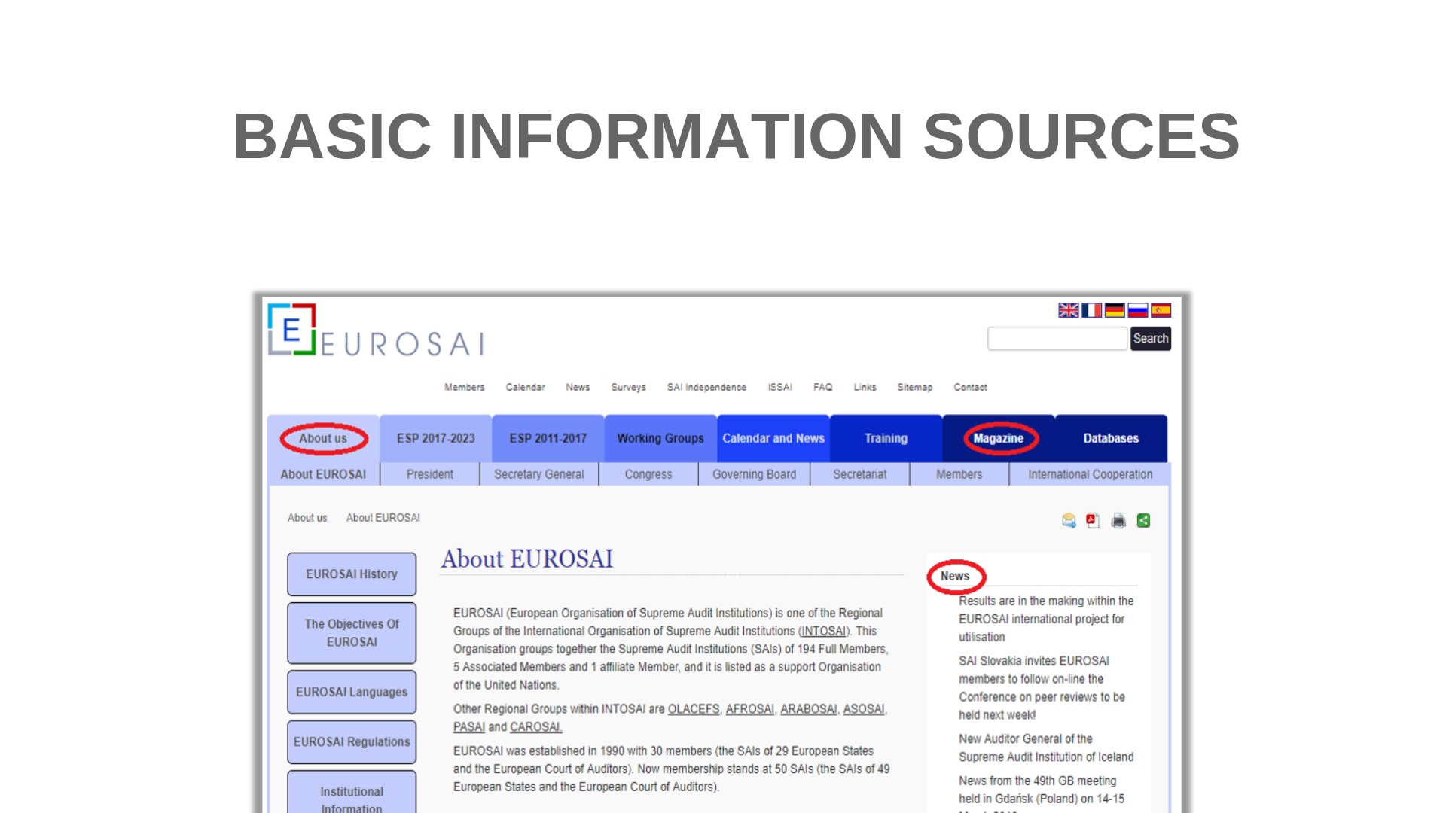
Notes:
Note for presenters: Please, during the presentation, mention all the main tabs. It is also possible (if the internet connection is available) to show it directly on the EUROSAI website (www.eurosai.org)
For a better orientation, the main information sources are shown in this slide. A basic description of the content of each part is included in the following slides.
Note for presenters: The following five slides contain short overviews about basic information sources. Please note and point out that this list does not include all the parts of EUROSAI website! Only the selected ones. Point it out to listeners and recommend them to have a look at the EUROSAI website (www.eurosai.org.)
About us - Basic information about EUROSAI – Status, Presidency, Secretary General, Congresses, Governing Board, Secretariat, Members and International Cooperation.
EUROSAI Magazine - The European Organisation of Supreme Audit Institutions publishes an annual EUROSAI magazine containing contributions of members of EUROSAI on their experiences and their ideas concerning the auditing of public resources and expenditure. It also reports on the most important activities by EUROSAI or its members and it devotes monographic articles to describe the authorities and functions of some specific Supreme Audit Institutions in particular. EUROSAI magazine is only printed in English, however it is available in an electronic format in the five official languages of EUROSAI.
News – This section includes e.g. up-to-date information about various events, documents, reports organised or published by EUROSAI or its Working Groups or Task Force – for example meetings, workshops, various training activities, reports from sessions, video tutorials, etc.

Slide 11
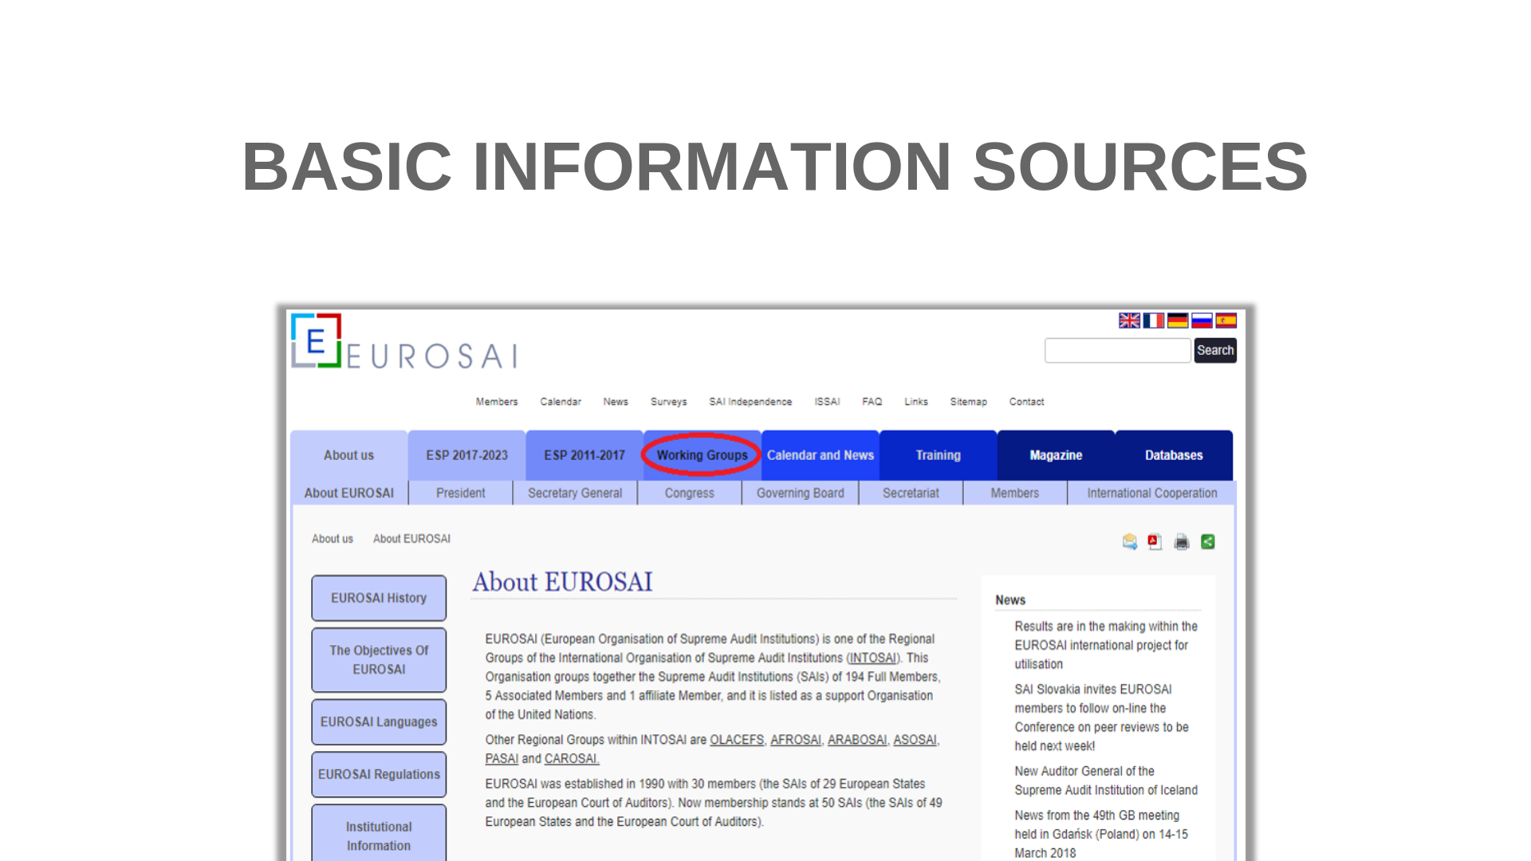
Notes:
Another important tab that we would like to highlight is the tab concerning Working Groups.

Slide 12
Notes:
Working Groups and Task Force
In compliance with article 9.5 of the EUROSAI Statutes and 13 of the Standard Procedures, the EUROSAI Congress is authorised to create technical commissions and study groups and determine their functions.
These bodies were established to support the Congress at a technical level, in concrete projects and initiatives. They are entrusted with specific mandates. These bodies can be created on a permanent basis or for a limited duration for developing ad hoc tasks. The establishment, provision with new mandates and dissolution of these bodies are the responsibility of the Congress.
The EUROSAI Governing Board can also establish project/study groups, task forces and committees to support the implementation of actions that come under its competence or are mandated by the Congress. The Working Groups, Task Forces and Committees consist of EUROSAI members and report their work to the EUROSAI Governing Board.
EUROSAI members can participate in these bodies on a voluntary basis. Each Working Group, Task Force shall elect its own chairperson.

Slide 13
Notes:
EUROSAI currently has three Working Groups and two Task Forces addressing areas with special priority to EUROSAI:
Working Group on Information Technologies (IT), established in 2002 (V Congress). Chair: SAI of Poland.
Working Group on Environmental Audit, established in 1999 (IV Congress). Chair: SAI of Estonia.
Working Group on Audit of Funds Allocated to Disasters and Catastrophes, established as a Task Force in 2008 (VII Congress) and transformed into a Working Group in 2014 (IX Congress). Chair: SAI of Ukraine.
Task Force on Audit and Ethics, established in 2011 (VIII Congress). Chair: SAI of Portugal.
Task Force on Municipality Audit, established in 2016 (44th Governing Board). Chair: SAI of Lithuania.

Slide 14
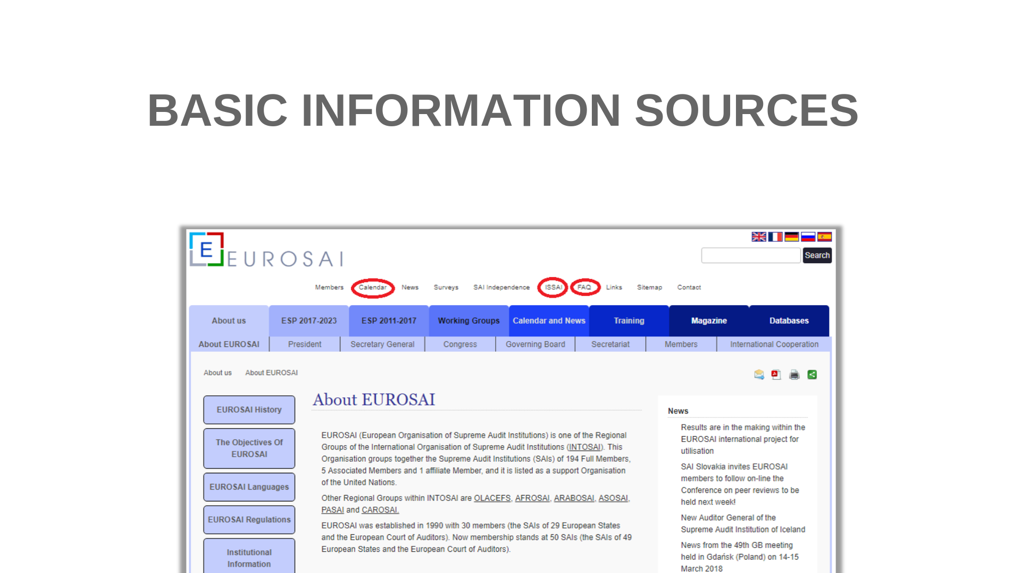
Notes:
Note for presenters: Please, during the presentation, mention all of them. It is also possible (if the internet connection is available) to show it directly on the EUROSAI website (www.eurosai.org)
For better orientation, the main information sources are shown in this slide. A basic description of the content of each part is included in the following slides.
ISSAIs - The International Standards of Supreme Audit Institutions (ISSAI) state fundamental prerequisites for duly functioning and professional conduct of SAIs and fundamental principles in auditing of public entities. They are issued by the International Organisation of Supreme Audit Institutions. The INTOSAI Guidance for Good Governance (INTOSAI-GOV) provides guidance to public authorities on the proper administration of public funds. These standards offer guidance for all SAIs which are fully independent in deciding whether and to what extent to rely on the tools comprised in the ISSAI framework.
In its Strategic Plan 2011-2017 EUROSAI has committed itself to providing high quality translation of ISSAIs and INTOSAI GOVs into the official EUROSAI languages.
Note for presenters: For more information see www.issai.org please.
Calendar - here you can easily find all upcoming events organised either by EUROSAI or its Working Groups and Task forces.
FAQ - frequently asked questions about EUROSAI activities, including the updating protocol EUROSAI Website. This document is intended to establish general principles and to define routines to update the EUROSAI website and its information. It identifies rules and procedures to ensure updating of the content of the website by editors under the EUROSAI Secretariat’s coordination. In case you have any idea of filling in the information on the website, consult these procedures please.

Slide 15
Notes:
EUROSAI databases
Note for presenters:
The following three slides are dedicated to databases.
Database of audits
Database of products
Database of training events and outputs
The creation of these databases was established in the GT3 operational plan. Their further development and maintenance was entrusted to Strategic goal 1 within the current Strategic Plan. All the databases are continuously updated.
It is also possible (if the internet connection is available) to show it directly on the EUROSAI website (www.eurosai.org)
Database of audits
This database was created to concentrate all the information from published audit reports which were produced by EUROSAI members in one spot. The database is designed to contain basic information concerning audit reports, other documents and links to materials. There is also a search engine. The database is continuously being updated. EUROSAI SAIs add their finished audit reports on a regular basis. Audit reports are put into database via a special template form. A short video tutorial was created for the purpose to show illustratively how to add audit reports into the database. This video is at disposal for users of the database on the EUROSAI website. There are audits from as early as 2001 but most of the audit materials are from recent years.
There is a fixed structure of individual items in the database. In the database you can find basic information about audit reports:
Audit title in English
Audit title in original language
Subject area
Year of publication
Type of audit – compliance, financial and performance
Short description
Country of origin
Materials available
Type of performance
Contact
In the field “Type of performance“ - you can find out if the audit was conducted individually by a SAI or as a cooperative audit.

Slide 16
Notes:
Database of products
The intention of this database is to concentrate all the products available in one spot for a better orientation in the field of auditing. There is also a search engine to find the right information faster.
This database contains various products of INTOSAI and EUROSAI WGs and Committees (e.g. Contact committee). Under the word “products“ we mean e.g. publications, guidelines, handbooks, minutes from meetings, general materials etc. The database is created in the same way as the database of audits – links, documents (usually in PDF format) to the products and other information such as:
Title
Source (WG/TF/general)
Type of document
Subject areas
Year of publication
Country of origin and language
Website
This database works on a different principle than the database of audits. Products are added to this database by EUROSAI Strategic Goal 1 team members. If you have any product that you would like to add or that you know about a product that you find useful for auditors, do not hesitate to contact us so we can add it to the database at: eurosai.sg1@nku.cz.

Slide 17
Notes:
Database of training events and outputs
This database contains information related to the realised and planned training activities of EUROSAI. Through the search machine you can look for information in the documents from already realised events.
For the realised training events you can find following information:
Event ID and Event Title
Subject Area
Event Data and Venue
Short Description
Organiser-Contact and Materials
List of Participants
Target Audience
Programme
Materials (presentations, evaluation, etc.)
Support

Slide 18
Notes:
The database of surveys contains basic information and links concerning surveys issued by EUROSAI structures (Working Groups, Task Forces, Committees, Project Groups, etc.) by INTOSAI or its Regional Organizations, by Supreme Audit Institutions or even by other organizations, where relevant.
The intention of this database is to disseminate the information about surveys issued and, where possible, also the information about the results of those surveys. Further information can be obtained through the contacts indicated on the surveys.
The maintenance of this database is entrusted to Strategic Goal 1.
To search in the database you can use the TOPIC and SUBTOPICS Chart.
If you want to add any relevant survey, or in case of any questions or suggestions, please contact: eurosaisurveys@tcontas.pt

Slide 19
Notes:
Conclusion:
We hope that this presentation has given you basic information about the EUROSAI website and a short overview where to find various useful information.
This presentation was created by EUROSAI Strategic Goal 1 and previously by EUROSAI GT3.
In case of questions do not hesitate to contact us on eurosai.sg1@nku.cz or the team leaders: michaela.rosecka@nku.cz or marketa.molnarova@nku.cz.

